Slide 1
How can we ensure that health authorities reproduce the sponsor's R based submission results? Renfa He, He Liu Mar. 28, 2025

Slide 2
Agenda
Introduction (Renfa) | Setup Environment (He Liu)
Preliminary Steps (Renfa) | Challenge & Recommendation (He Liu)
ADRG (Renfa) | Q&A
Key Takeaways (Renfa)
1
5
2
6
3
7
4

Slide 3


Introduction
Reproducibility is a critical aspect of any submission to health authorities (HAs), below are key considerations for ensuring reproducibility in submission with R deliverables:
Good preparation of deliverables
Good documentation (ADRG)
Multi-peer review and testing before the submission
Collaboration with HAs to address reproducibility challenges

Slide 4
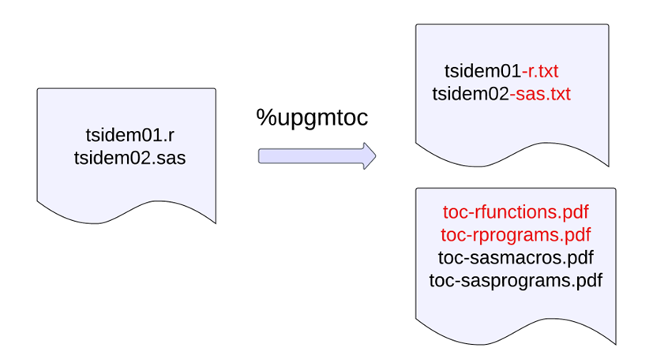
Preliminary Steps
!!! Communicate and inform HAs that (part of) the submission will be generated in R
Conversion of submitted programs to –extension.txt
Creation of separate TOC files that list R programs/functions

Slide 5
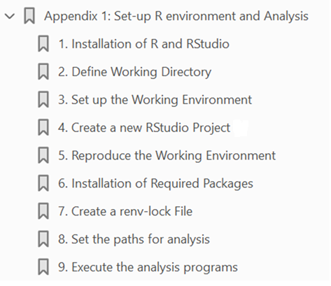
ADRG
Adding new sections to describe the components of R deliverables, and the setup of R environment
Information on submitted files
Information on R packages used, including version and description
Information on R functions used, including a description
Additional 'Appendix' for detailed steps regarding to R environment set up

Slide 6
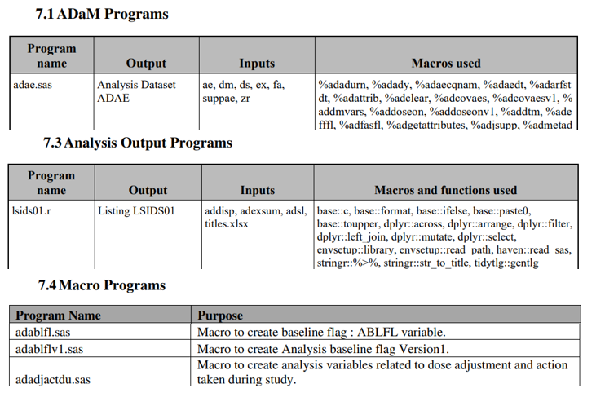
ADRG
Create overview of macros and functions used in submitted scripts

Slide 7
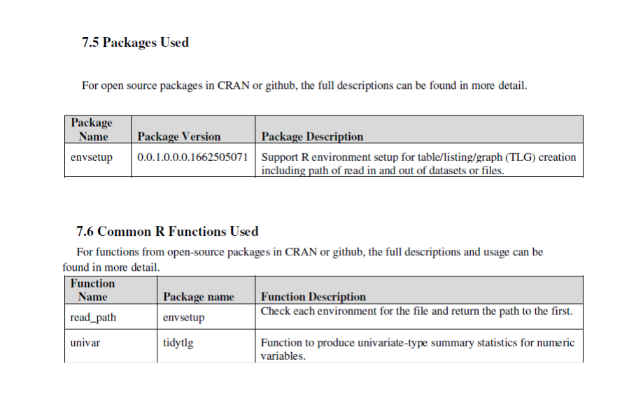
ADRG
Environment metadata required (packages, versions, file paths, …)

Slide 8
Key Takeaways
Most important: Reproducibility – Stable R version and environment
Sponsors should engage the FDA review team early to agree upon version of R and compatible R package versions
Traditional approach using pkglite can be avoided by changing file extensions to .txt with instructions to revert to original extension
R package as zip file was succesfully transferred via eCDT gateway and used in reproducing Pilot 3. Note that underscores need to be replaced by hyphen and instructions for renaming should be documented in ADRG
Use of absolute paths in ADRG rather than relative paths eg “./opath”
NMPA submission, translated ADRG in Chinese and updated per NMPA submission requirements, eg replace 'misc' folder with 'dataset' folder

Slide 9
Setup Environment – Real Case Sharing

Slide 10
Key Steps for Setup of the R Environment
Installing R and RStudio
The ADRG document provides detailed instructions for installing R and RStudio to ensure reproducibility. For example, it specifies downloading R 4.2.1 and RStudio 2023.03.1+446.pro1:
Download and install R 4.2.1 for Windows from https://cran.r-project.org/bin/windows/base/old/4.2.1/.
Download RStudio Desktop for Windows by visiting https://dailies.rstudio.com/version/2023.03.1+446.pro1/. !!! These steps are fundamental to establishing a consistent R environment

Slide 11
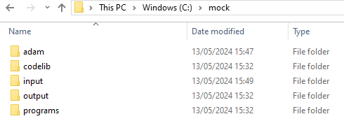
Key Steps for Setup of the R Environment
Defining the Working Directory
Creating a working directory like "C:\mock" and copying the submission folder into it ensures that all analysis steps are executed in this location. Creating subfolders that mimics the sponsor’s analysis structure.

Slide 12
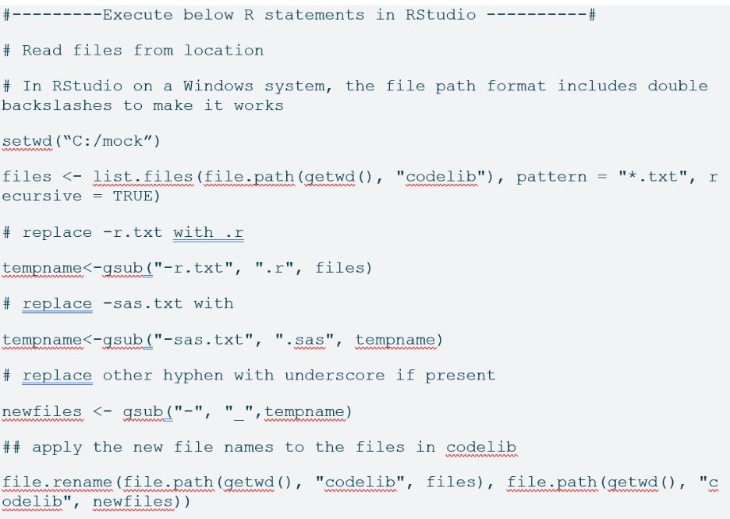
Key Steps for Setup of the R Environment
Setup the Working Environment
Provide Codes to convert the deliverables to original format and placing them in corresponding new subfolders.
E.g.
XPT to SAS7BDAT: %xpt2sas(type=ADAM, indir=C:\mock\xpt, outdir=C:\mock\adam);
XPT to XLSX : %escnxpt2extrn(indir= C:\mock\xpt ,outdir= C:\mock\input ,sheetlist=%str(Sheet1),xptlist=%str(titles),filelist=%str(titles.xlsx),fileextlist=xlsx);​
R Code to convert “.txt” to“.sas”/”.r”

Slide 13
Key Steps for Setup of the R Environment​
Reproduce the Working Environment
In the R session, install the required packages listed in packages.txt (located at “.\m5\datasets\jnjcompound01\misc”). The packages can be installed by running the code below in RStudio.
setwd('C:/mock’);
install.packages("remotes")
Install the {renv} package, version 1.0.3, which supports reproducible environments for R
options(renv.consent = TRUE);
remotes::install_version("renv", version = "1.0.3")
Installing required packages
renv::init(bare = TRUE, repos = "https://packagemanager.posit.co/cran/2022-09-15")
pkgs <- read.csv(file.path(getwd(), "m5/datasets/jnjcompound01/misc/packages.txt"))
install.packages(pkgs$Package, repos = "https://packagemanager.posit.co/cran/2022-09-15")
PS: After the packages installation is complete, recommended to use the renv::status() command to check ensure the required packages were installed successfully . If any packages installation failure due to network firewall settings/governmental regulatory role, then install package manually .

Slide 14
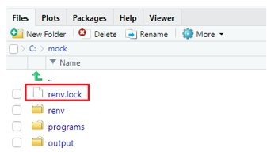
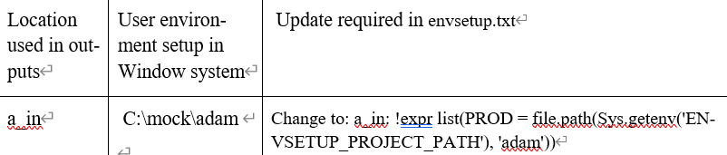
Key Steps for Setup of the R Environment
Create a renv-lock File
Creating the renv- lock file is crucial for maintaining a consistent R environment
renv::snapshot(type = "all", repos = "https://packagemanager.posit.co/cran/2022-09-15")
Set the paths for analysis
Configuring environment variables is essential for reproducibility. That updating the "envsetup.txt" file to reflect the correct paths for input files and output folders ensures that all analysis steps are executed in the correct environment. After the settings are made, manually add the below code to .Rprofile.
envsetup::rprofile(config::get(file = file.path(getwd(), "m5/datasets/jnjcompound01/misc/envsetup.txt"

Slide 15
Challenges & Recommendations
Challenges/Findings, from R consortium & internal testing/submissions
Replicating the sponsor’s R environment
Different operating systems require different settings and generate different warnings
→in the ‘renv’ set up, different options might need to be selected to make it work
Different R versions don’t perform similarly
Not ideal to switch R versions in Rstudio for every submission
→‘renv’ package is part of the solution to reproduce the R environment but creates challenges when transferred between different operating systems
Recommendations/Exploration
Add the question in the pre submission briefing book
Use CRAN or a curated repo for sourcing packages (github is allowed)
Use standard packages and minimize dependencies on sponsor developed packages
Recommended to use zip files of sponsor’s packages rather than pkglite
!!!Provide thorough documentation and detailed comments in ADRG

Slide 16
References
Useful links
R Consortium Pilot 1, https://github.com/RConsortium/submissions-pilot1-to-fda
R Consortium Pilot 2, https://github.com/RConsortium/submissions-pilot2-to-fda
R Consortium Pilot 3, https://github.com/RConsortium/submissions-pilot3-adam-to-fda
Novo Nordisk’s R submission, https://www.youtube.com/watch?v=t33dS17QHuA
Roche, https://www.youtube.com/watch?v=BlJNILSoZlM

Slide 17
Acknowledgements
R submission SME team: Heidi, Renping, Xin, Haining, Steven, Riki, Alex, Linshan, Renfa
R testing team: Coral, Diye, Yufan, Weilong, Yaxing, Wenlan, Yinghua, Lingsong, Xin
Shechang Li’s suggestion

Slide 18
Q&A
THANK YOU

